Slide 1


ADMASTER-STAMP!1327234-0922
Rimini Street
Voya
Supplemental Health Plans Review
1.1.2026

Slide 2
Supplemental Health Plans
Supplemental Health Plans pay benefits directly to you
If you, your spouse, or children face an accidental injury, hospital stay,
or diagnosis of a critical illness like cancer, heart attack, or stroke
Critical Illness Insurance
Pays a lump-sum benefit of $5,000, $10,000, $15,000 or $20,000 if diagnosed with a covered critical illness like heart attack, stroke, cancer, etc.
Spouse and Children can be covered at 50% of your elected benefit amount
Accident Insurance
Pays benefits for treatment of injuries resulting from a covered accident. Benefits include but are not limited to: ER or Urgent Care visits, hospital confinement, fractures, dislocations, surgeries, coma, etc. Benefits are cumulative, so for serious injuries with many treatment points, the larger the total benefit payment..
Hospital Indemnity Insurance
Pays a $1,000 Admission benefit for initial day of hospital confinement and $200 Daily benefit up to 30 days for a covered stay in a hospital, critical care unit or rehabilitation facility
No Pre-Existing condition limitations, including for childbirth
*Covered events, including childbirth, must occur on or after effective date of coverage
These are limited benefit policies. This is not health insurance and does not satisfy the requirement of minimum essential coverage under the Affordable Care Act.

Slide 3

Critical Illness Overview
Critical Illness Plan: Employee Benefit Options $10k, $20k, $30k, $40k
NEW: Enhanced Benefits Effective 1.1.2026
Enhancements available for all new and current participants
No change to rates for currently enrolled employees
Newly Added Benefits:
Sudden Cardiac Arrest 100%
Type 1 Diabetes 100%
Severe Burns 100%
Muscular Dystrophy 100%
Bone Marrow Transplant 25%
Stem Cell Transplant 25%
Childhood Conditions 100%
Cerebral Palsy
Congenital Birth Defects
Down Syndrome
Wellness: $100 per year for Employee, Spouse, and Children
Child Wellness at $100 is an enhancement for currently enrolled employees.
Previously, Child Wellness was 50% of Employee Wellness benefit

Slide 4
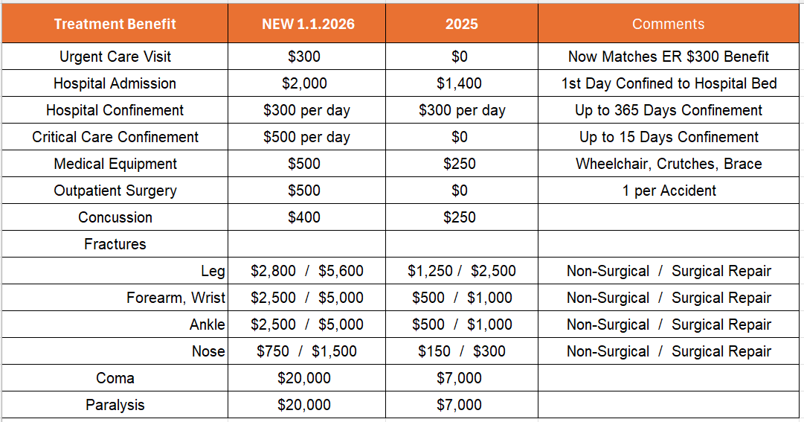
Critical Illness Overview
Accident Plan
NEW Enhancements Effective 1.1.2026
Enhancements available for all new and current participants
No change to rates for currently enrolled employees
Wellness: $100 per year for Employee, Spouse, and Children
Child Wellness at $100 is an enhancement for currently enrolled employees.
Previously, Child Wellness was 50% of Employee Wellness benefit

Slide 5
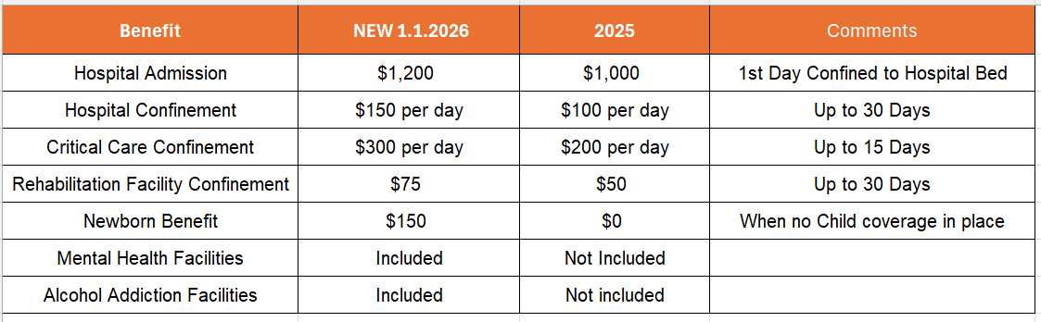
Critical Illness Overview
Hospital Plan
NEW Enhancements Effective 1.1.2026
Enhancements available for all new and current participants
No change to rates for currently enrolled employees

Slide 6
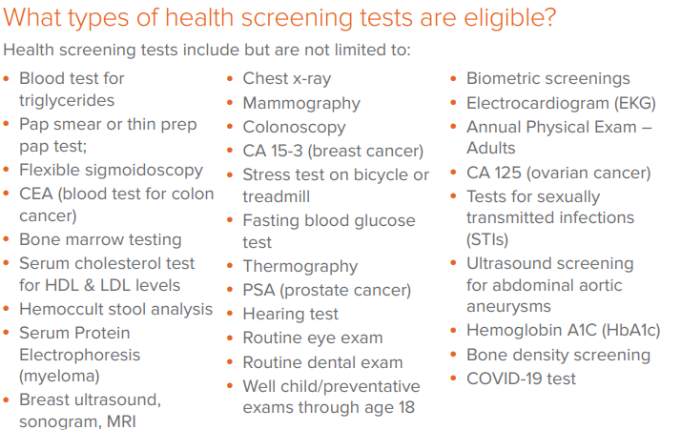
Critical Illness Overview
Wellness Benefit

Slide 7

Critical Illness Overview
How Do I File a Wellness Claim
voyaclaims.com
Click “Get Started” on the “Start a Claim” tile
Click “Let’s get started” at bottom of the landing page
In the dropdown for “Which choice best describes you?”
Employee selects “Policyholder”
The system will prompt you through
*No proof of service required for Wellness claims

Slide 8

Voya Microsite – Employee Benefits Resource Center
Customized Microsite
Houses all things Voya
Benefit Summaries
FAQs
Short Videos
Real Life Examples
File a Claim right from the site
Link: https://presents.voya.com/EBRC/rimini

Slide 9
Thank you!

